Slide 1


Careers in the health sector:
What’s new? What’s changing?
Alan Simmons
Careers Specialist, Health Careers

Slide 2

Content:
Background/context
Patient journey
Getting in
Trends, changes and new roles
Resources from Health Careers
Using the NHS Jobs website

Slide 3

Background/
context

Slide 4

This figure includes NHS staff in Wales, Scotland and Northern Ireland too
www.healthcareers.nhs.uk
@HealthCareersUK
advice@healthcareers.nhs.uk

Slide 5
Staff in the NHS 2016 (approximately!)
www.healthcareers.nhs.uk
@HealthCareersUK
advice@healthcareers.nhs.uk

Slide 6





Since Health & Social Care Act 2012…
More than 1,000 organisations currently deliver NHS services in England
NHS Acute (hospital) or
other NHS organisation
Private healthcare
provider
GP
Social Enterprise/
Community Interest
Company
Clinical Commissioning Group
GP
GP
Nurse
Other healthcare professionals
Charity
Consultant
GP
GP
GP

Slide 7
Patient journey

Slide 8






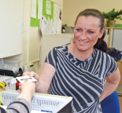
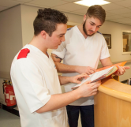





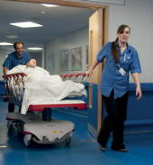

Danny’s playing football
Danny falls & injures his leg
His friend dials 999 & speaks to an emergency medical despatcher, who despatches an ambulance
Example of a patient journey
Porter helps transport Danny into the building
Take him to A & E department of local hospital
Paramedic & emergency care assistant assess situation
Triage nurse gets second opinion of emergency medicine doctor
Danny’s details are recorded by receptionist
Triage nurse assesses his leg
They arrange an X-ray taken by a diagnostic radiographer
And a biomedical scientist in the path lab checks it out
A phlebotomist takes some blood
His leg is broken and needs surgery
Danny has surgery. The team includes an orthopaedic surgeon, anaesthetist, ODP, theatre nurse, & HCA
Porter takes Danny to the ward
Danny’s cared for by a children’s nurse & HCA

Slide 9



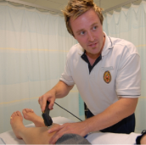



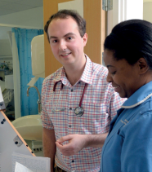
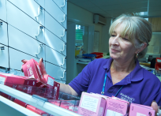



He has food prepared by a chef
Clean laundry from linen and laundry staff
Before he’s discharged, his orthopaedic surgeon sees him on the ward
Example of a patient journey
He sees a physiotherapist at home for follow up rehabilitation treatment
He’s then transported home by an ambulance care assistant from the PTS
He sees his GP and the practice nurse
The GP prescribes him some medication from the pharmacist
But Danny’s still in pain and goes back to his doctors’ surgery
A few weeks later, Danny’s playing football again!
An occupational therapy support worker visits to check he’s progressing
A few days later, the district nurse comes to remove his stitches

Slide 10



Staff that Danny saw
Examples of staff that Danny didn’t see but who contributed to his ‘patient journey’
paramedic
emergency care assistant
porter
receptionist
triage nurse
emergency medicine doctor
diagnostic radiographer
phlebotomist
orthopaedic surgeon
anaesthetist
operating department practitioner
theatre nurse
health care assistant
children’s nurse
ambulance care assistant
physiotherapist
GP (general practitioner)
practice nurse
pharmacist
district nurse
occupational therapy support worker
emergency medical despatcher
biomedical scientists
chefs
linen and laundry staff
See this and other patient journeys (including videos and other resources) on the Health Careers website
security staff
gardeners
IT staff
estates maintenance staff
clinical scientist in radiation safety physics
managers
accountants
human resources staff
communications and PR staff
health informatics staff
librarians
decontamination science staff

Slide 11
Getting in

Slide 12
Enter at different levels
(depending on the job)
Through an apprenticeship/job/training
After a course at a further education college
By taking an approved university degree
After a degree
After experience gained outside of the NHS
www.healthcareers.nhs.uk
@HealthCareersUK
advice@healthcareers.nhs.uk

Slide 13
Apprenticeships in the health sector in the last *3 months (examples)
Healthcare apprentice - theatres | Taunton
Podiatry apprentice | Northampton
Apprentice radiology department assistant | Norfolk
Human resources apprentice | Exeter
Non-emergency Patient Transport Service apprentice | Worcester
Design and communications apprentice | Bristol
Apprentice clinical support worker | Wirral
Business administration apprentice | London
Apprentice dental nurse | Leeds
Pharmacy technician – advanced apprenticeship | Nottingham
Trainee/apprentice Dispenser | Warwickshire
Apprentice healthcare assistant | Huddersfield
Purchasing and supply chain apprentice | Chester
Medical engineering apprentice | Preston
Digital communications apprentice | Poole
Apprentice clinical coder | Yorkshire
Apprentice maintenance carpenter | Southampton
Healthcare apprentice | Dartford
*As advertised on NHS Jobs
www.jobs.nhs.uk
Candidates should also search on the National Apprenticeships website
www.gov.uk/apply-apprenticeship

Slide 14
Trends, changes and new roles

Slide 15


Will you fit in?
If you apply for a job or apprenticeship vacancy with the NHS, or a university course with placements in the NHS, you’ll need to show how you think the values of the NHS Constitution apply in your everyday work:
Do you have what it takes? If you’re applying for a support role in the NHS, try the E-values tool on the NHS Jobs website www.jobs.nhs.uk
www.healthcareers.nhs.uk
@HealthCareersUK
advice@healthcareers.nhs.uk

Slide 16
Trends, changes and new roles
Increase in the number of:
  apprenticeships offered by NHS (20,000 in 2015-16 and target of 19,000 in 2016/17)
  paramedic science places at university
  psychological wellbeing practitioners especially to work with children
  places at medical school (up to 1,500 an additional places from 2018)
  places on the NHS Graduate Management Training Scheme (up to 200 from 2018)
Physician associate:
  postgraduate-trained, working under supervision of a doctor
  considerable expansion of university places in 2015/16/17
Changes to financial support for students on pre-registration healthcare courses
Nursing degree apprenticeships:
  apprenticeship standard confirmed Nov 2016
  first intake could be starting Sept 2017
Nursing associate:
  new role between healthcare assistant and registered nurse
  being piloted in 2016/17 – two intakes of 1,000 associates each
  will be regulated by the Nursing and Midwifery Council
www.healthcareers.nhs.uk
@HealthCareersUK
advice@healthcareers.nhs.uk
Notes:
http://www.councilofdeans.org.uk/2015/11/the-2015-spending-review-changes-to-nursing-midwifery-and-ahp-education-background-information-for-students/

Slide 17

Examples of routes into nursing in England
Registration with the NMC
He completes a 4-year nursing degree apprenticeship in mental health nursing
Takes a shortened/ accelerated
full-time
pre-registration degree in adult nursing
She takes a shortened nursing degree apprenticeship in learning disability nursing
She takes a 3-year full-time
pre-registration degree in children’s nursing
He takes an 18-month advanced apprenticeship in health & social care where he works as a senior healthcare support worker with patients with mental ill health
She gets recognition of her first degree through APEL
She takes 2-year training as a nursing associate
Kelly is 21 and has just completed a first degree in psychology. She’s interested in adult nursing
Shipa is 28, has 3 A-levels in chemistry, psychology and English and wants to be a children’s nurse
Carmel is 18 and has 5 GCSEs A-C including maths and English. She enjoys her p/t job in a school with students with special needs
Nigel is 36 , has GCSEs in maths and English. He works as a healthcare assistant and completes the Care Certificate
www.healthcareers.nhs.uk
@HealthCareersUK
advice@healthcareers.nhs.uk
Notes:
http://www.councilofdeans.org.uk/2015/11/the-2015-spending-review-changes-to-nursing-midwifery-and-ahp-education-background-information-for-students/

Slide 18
NHS student support – up until August 2017
Students starting NHS-approved pre-registration courses in:
Nursing Midwifery Physiotherapy Radiography Dietetics Dental hygiene Dental therapy | Occupational therapy Speech & language therapy Orthoptics Prosthetics/Orthotics podiatry Operating department practice
Currently receive:
payment of tuition fees
a non means-tested grant
means-tested bursary available
More information? www.nhsbsa.nhs.uk/students
www.healthcareers.nhs.uk
@HealthCareersUK
advice@healthcareers.nhs.uk
Notes:
http://www.councilofdeans.org.uk/2015/11/the-2015-spending-review-changes-to-nursing-midwifery-and-ahp-education-background-information-for-students/

Slide 19
NHS student support – from 1 August 2017
Students applying to study for most health courses will need to apply for a student loan rather than receive an NHS bursary.
Financial support available under the new system includes:
    25% more up front financial living cost support while studying compared to a NHS bursary. For example a single student studying on a three year programme would receive approximately £2,000 more funding support per year on a student loan
    a non-repayable grant of £1,000 per year for students with child dependants
    access to an exceptional support fund of up to £3,000 per year for those students facing severe hardship
    support for excess travel and dual accommodation expenses incurred owing to attending practice placements
More information: www.nhsbsa.nhs.uk/students
www.gov.uk/student-finance
www.thefundingclinic.org.uk
www.healthcareers.nhs.uk
@HealthCareersUK
advice@healthcareers.nhs.uk
Notes:
http://www.councilofdeans.org.uk/2015/11/the-2015-spending-review-changes-to-nursing-midwifery-and-ahp-education-background-information-for-students/

Slide 20
NHS student support – from 1 August 2017
Exceptions for 2017 entry only
Postgraduate pre-registration students: For students starting their courses in 2017, the NHS will continue to pay tuition fees and means tested bursaries will still be available
Dental hygiene/dental therapy students: For students starting their courses in 2017, the NHS will continue to pay tuition fees and means tested bursaries will still be available
Part-time programmes: For a capped number of students on eligible programmes commencing in 2017/18, they will be able to apply for available support from Student Loans Company and will have access to a maintenance bursary from NHS Business Services Authority
More information? www.nhsbsa.nhs.uk/students
Students on degrees in medicine and dentistry
Outside of the scope of the financial changes announced in November 2015 as attracts different NHS funding anyway. However, no decisions yet made beyond 2017 entry
www.healthcareers.nhs.uk
@HealthCareersUK
advice@healthcareers.nhs.uk
Notes:
http://www.councilofdeans.org.uk/2015/11/the-2015-spending-review-changes-to-nursing-midwifery-and-ahp-education-background-information-for-students/

Slide 21
Resources from Health Careers

Slide 22





Contact details
advice@healthcareers.nhs.uk
Health Careers
PO Box 27079
Glasgow
G3 9EJ
0345 60 60 655
www.healthcareers.nhs.uk (main site)
www.stepintothenhs.nhs.uk (for 14-19 year olds)
www.facebook.com/HealthCareersUK
www.youtube.com/users/nhscareers
Twitter @HealthCareersUK

Slide 23












Health Careers literature
Currently available as download only but will be available to order later in March 2017
Organisations can order copies of these by contacting Health Careers
3 additional publications are in development and will cover careers in the psychological therapies; pharmacy and public health

Slide 24


Health Careers website
Search the site
Share pages through social media
Rotating carousel of images with links to further information
Quick access to information about NHS careers, medical careers and public health careers
If you register for an account, some of these tiles will be personalised, based on your interests
Quick links to key content
CF
Sum

Slide 25

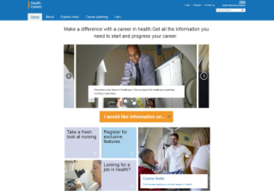




Health Careers website
Information on 250+ roles
Roles grouped under categories
Details for each role include:
  Working life
  Entry requirements
  Training
  Pay
  Further information
Real life stories
Videos
Compare up to 3 roles side-by-side
FAQs
Course finder
Events calendar
News
Choosing your options
Gaining experience (incl. WEX & volunteering)
Considering university
Planning your career
Developing your career
Resources
For those providing careers IAG:
  Teaching resources
  FAQs

Slide 26

Health Careers website – compare roles feature
Select up to 3 roles from the drop down list
Compare bite-size information about the selected roles side-by-side:
Role overview
Training and qualifications required
Expected working hours and salary range
Desirable skills and values
Prospects
Related roles

Slide 27







Statutory regulatory bodies for health staff
Health Careers website course finder
Dentists
Dental hygienists
Dental technologists
Dental therapists
Dental nurses
Clinical dental technicians
Orthodontic therapists
Midwives
Nurses
Arts therapists (art, music and
drama therapists)
Biomedical scientists
Clinical scientists
Dietitians
Hearing aid dispensers
Occupational therapists
Operating department
practitioners
Orthoptists
Orthotists/prosthetists
Paramedics
Physiotherapists
Podiatrists
Practitioner psychologists
Radiographers
Social workers (England only)
Speech & language therapists
Doctors
Environmental
health professionals
Pharmacists
Pharmacy technicians
Osteopaths
Optometrists
Dispensing opticians
Chiropractors
Step

Slide 28
Most course titles are as you’d expect, but…
Speech and language therapy
Speech and Language Therapy
Psychology and Speech Therapy
Human Communication
Speech and Language Sciences
Language Pathology
Speech and Language Pathology
Clinical Communication Studies
Therapeutic radiography
Radiography (therapeutic)
Radiotherapy
Radiotherapy and Oncology
Therapeutic Radiography
Radiography (Radiotherapy and Oncology)
Radiotherapy and Oncology in Practice
Dental hygiene/Dental therapy
Dental Therapy
Dental Hygiene
Oral Health Sciences
Dental Hygiene and Dental Therapy

Slide 29
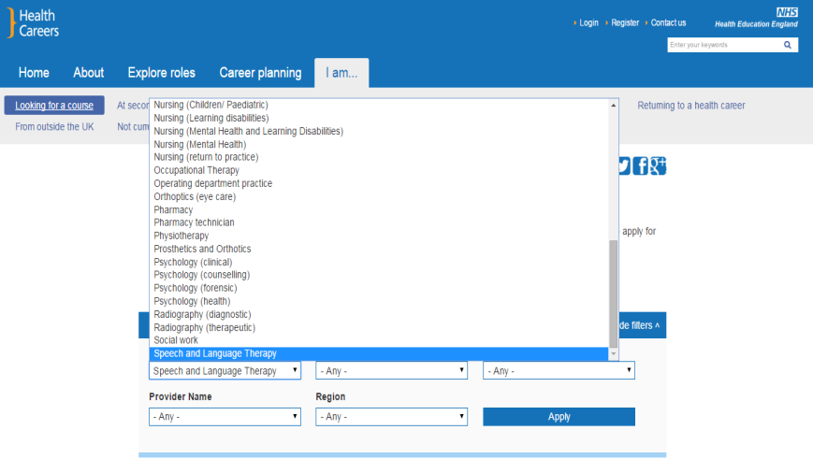
Health Careers website - course finder
Use drop down options in filters to search for courses

Slide 30

Health Careers course finder results page
Using the Health Careers course finder lists 16 undergrad courses leading to registration as a SLT with the Health and Care Professions Council (25 incl p/grad)
Course title
HEI contact details
HEI
Direct link to HEI website
Brief course details – mode of study, length of course, level of qualification
Step

Slide 31





Step into the NHS website (14-19 year olds)
Link to FB
Real-life examples of WEX placements
Career “mapper” – short quiz to suggest possible careers
66 roles listed
www.stepintothenhs.nhs.uk

Slide 32







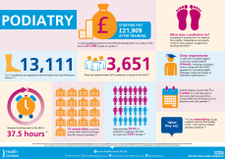



Other resources from Health Careers include...
Work experience
Toolkit for WEX
Co-ordinators in schools
Lesson Plans
Annual schools
competition
for year 8/9 students
Update – termly e-newsletter for careers professionals
Patient journeys
(teaching resource)
Occasional webchats for careers advisers and teachers
Infographics

Slide 33



Social media channels
Twitter - around 16,000 followers
You Tube - around 130 videos
Facebook

Slide 34
Using the NHS Jobs website
www.jobs.nhs.uk

Slide 35
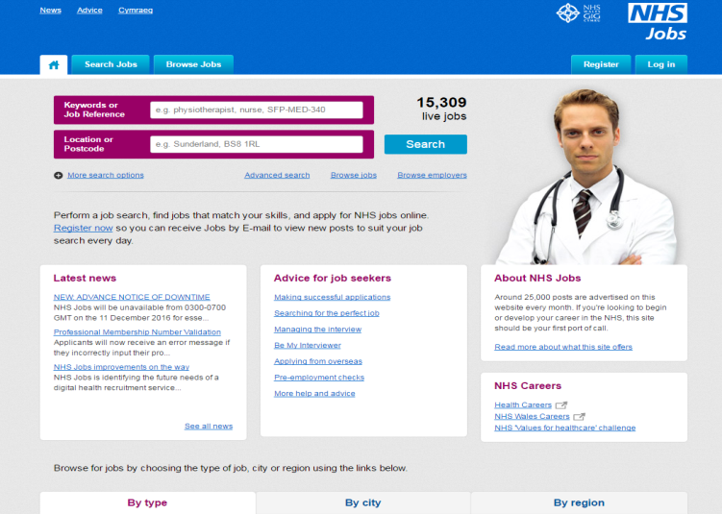
NHS Jobs website (England & Wales)
Browse vacancies by career groupings
Simple search facility. USE KEYWORDS!
Advanced search feature
Search for employers in your region
Register for job alerts by email
Vacancies often removed before closing date (usually stated this may happen).
Recommend signing up for jobs by email alerts!
How to apply, hints on applications and interviews etc
End
www.jobs.nhs.uk

Slide 36
Using the “keywords or job reference” field…
LOOKING FOR VACANCIES RELATED TO…
EXAMPLES OF RESULTING JOB VACANCIES
TRY SEARCH TERMS SUCH AS…
“healthy eating”, “diet”, “food”, “allergy”, “health promotion”, “nutrition”, “lifestyle”
Lifestyle support worker
Health development practitioner
Assistant nutritionist/dietitian
NUTRITION
“talking therapies”, “counselling”, “mental health”, “low intensity”, “high intensity”, “IAPT”
Substance misuse practitioner
Wellbeing Coordinator
Mental health advisor - trainee
PSYCHOLOGY
“marketing”, “project”, “payroll”, “finance”, “communication”, “record-keeping”
Marketing coordinator
Employment services officer (recruitment)
Finance assistant
ADMINISTRATION
SPORT SCIENCE
“exercise”, “fitness”, “lifestyle”, “stroke”, “physiology”, “cardiac rehabilitation”
Rehabilitation assistant
Health improvement practitioner
Cardiac physiologist
“laboratory”, “pathology”, “public health”, “healthcare science”, “health protection”
Training administration asst. (pathology)
Medical laboratory assistant – advanced
Newborn screening data manager
LIFE SCIENCES
“health improvement”, “health protection”, “substance misuse”, “smoking cessation”
Health promotion resource & info. officer
Integrated care drugs worker
Administrator (working at a prison)
PUBLIC HEALTH
www.jobs.nhs.uk
End

Slide 37

@HealthCareersUK
@Alan_Simmons
Thank you!

