Slide 1


Increasing exposure in primary schools:
Health Careers
De-brief for HEE, prepared by Kids Connections
Pev Murray: pev@kidsconnections.co.uk
Karen Gillon: karen@kidsconnections.co.uk

Slide 2

Today’s presentation
Background – Research design: Methodology and Sample
Careers and aspirations – a snapshot
Answering your objectives
  Exploring current awareness among the primary school audience of roles in health
  Gaining a better understanding of stereotypical views among primary school age children and their school teachers
  Identifying potential influences on stereotypical views among primary school children
  Exploring response among primary children and teachers to Step into the NHS website and materials
  Explore response among primary children and teachers to Step into the NHS website and materials
Conclusions

Slide 3
Research design

Slide 4
Objectives / Key Outcomes
To explore current awareness among a primary school audience of roles in health
To gain a better understanding of stereotypical views among primary school age children and their school teachers
To identify potential influences on stereotypical views of careers in health among primary school children
To explore opportunities in the KS2 curriculum for Health Careers to engage with primary schools, e.g teaching resources, competitions
To explore response among primary children and their teachers to Step into the NHS website and materials

Slide 5
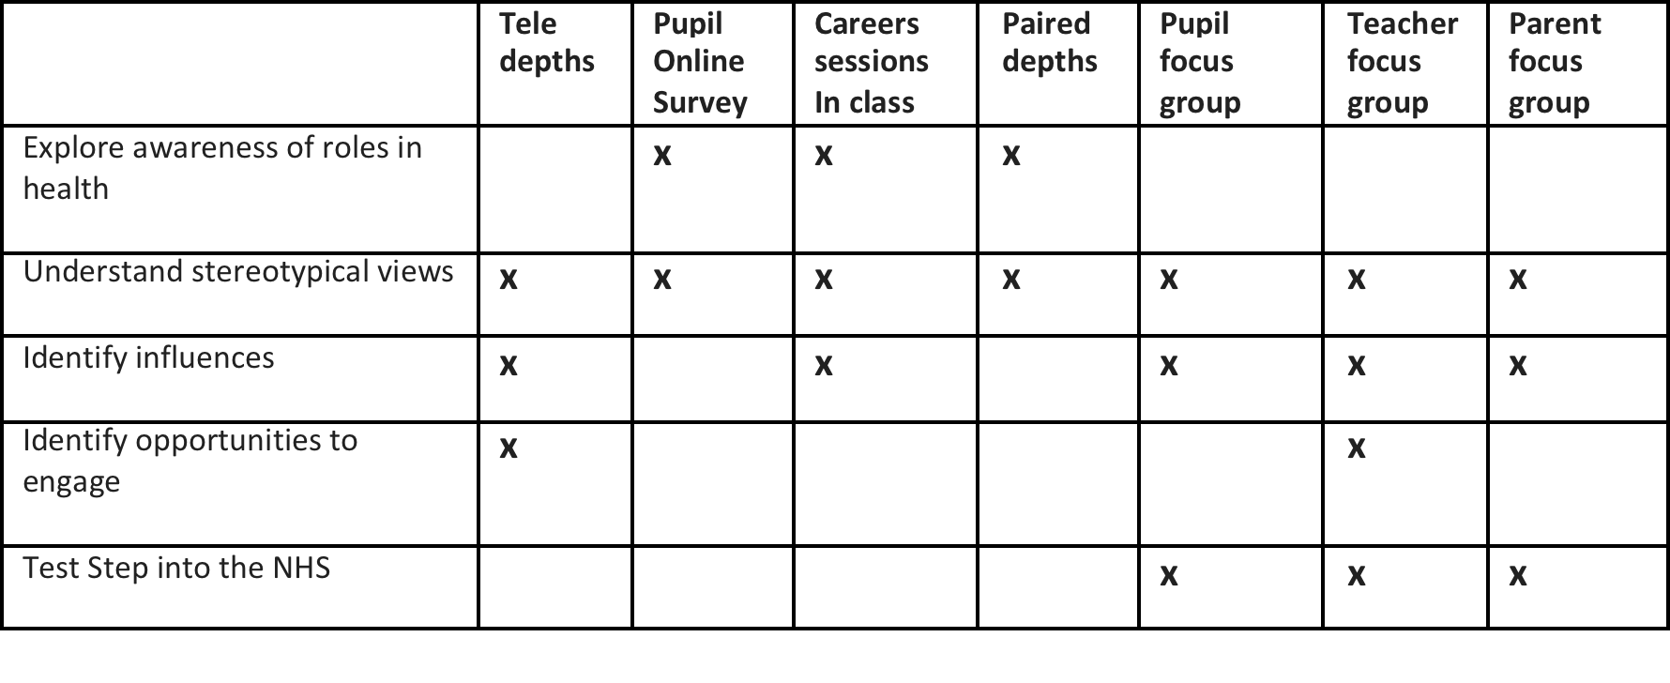
Mixed Methodologies Selected
A copy of the on-line survey and all the discussion guides used to shape the research are provided as Annex 1

Slide 6
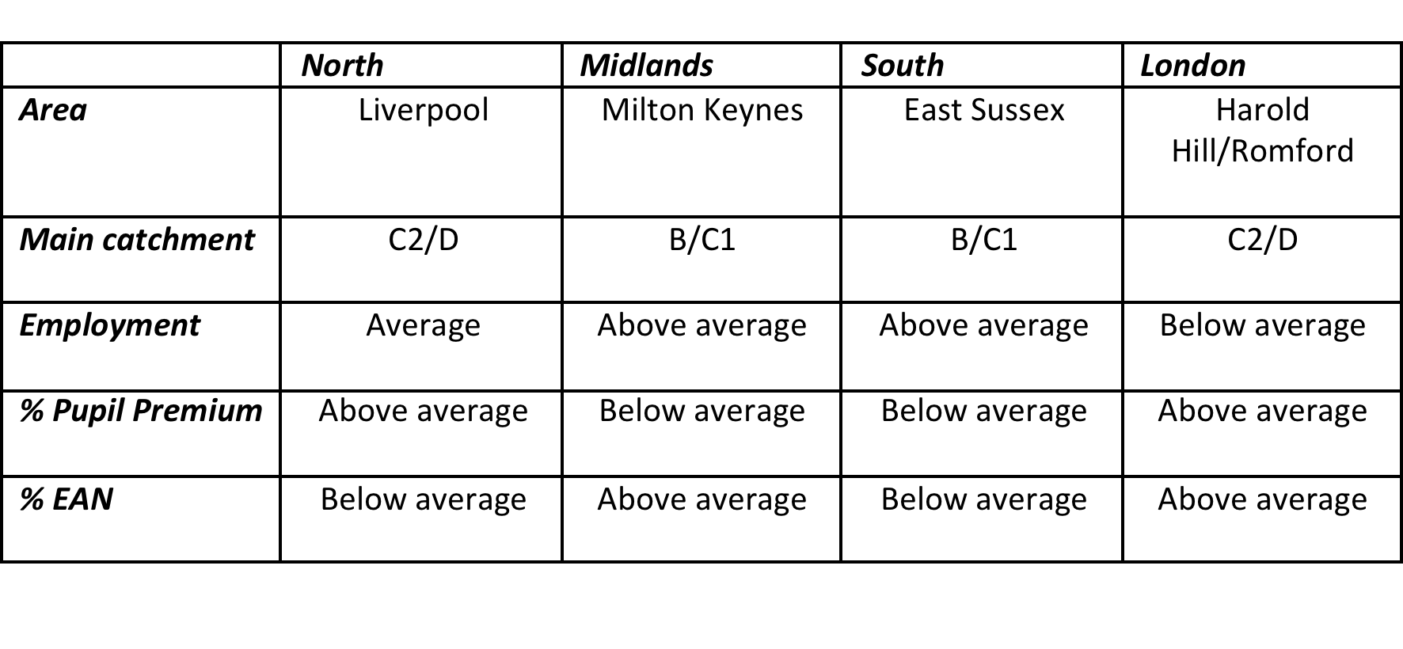
Research design: Core schools
Schools in 4 core areas, each delivering:
  On-line survey completed by Years 5 and 6, extended to Years 3 and 4 where possible
  Tele-depth interview with core staff member
  Careers session in class with c. 30 children (2 classes observed in one school)
  5 x paired depths with students
  Pupil focus groups with c. 8 respondents
  Teacher focus group with c. 4 members of staff

Slide 7
Research design: On-line survey
Methodology
  On-line survey completed by pupils from the core schools
  Surveys completed in schools (supervised but not directed)
  Tracking applied to identify individual school responses
Response
  716 completed surveys (755 including incompletes)
    51% girls : 49% boys
    C. 1/3 of sample in Years 3 and 4
    C. 2/3 of sample in Years 5 and 6
    Almost 70% of sample aged 9-11 years
    Response from individual schools proportional to school intake

Slide 8
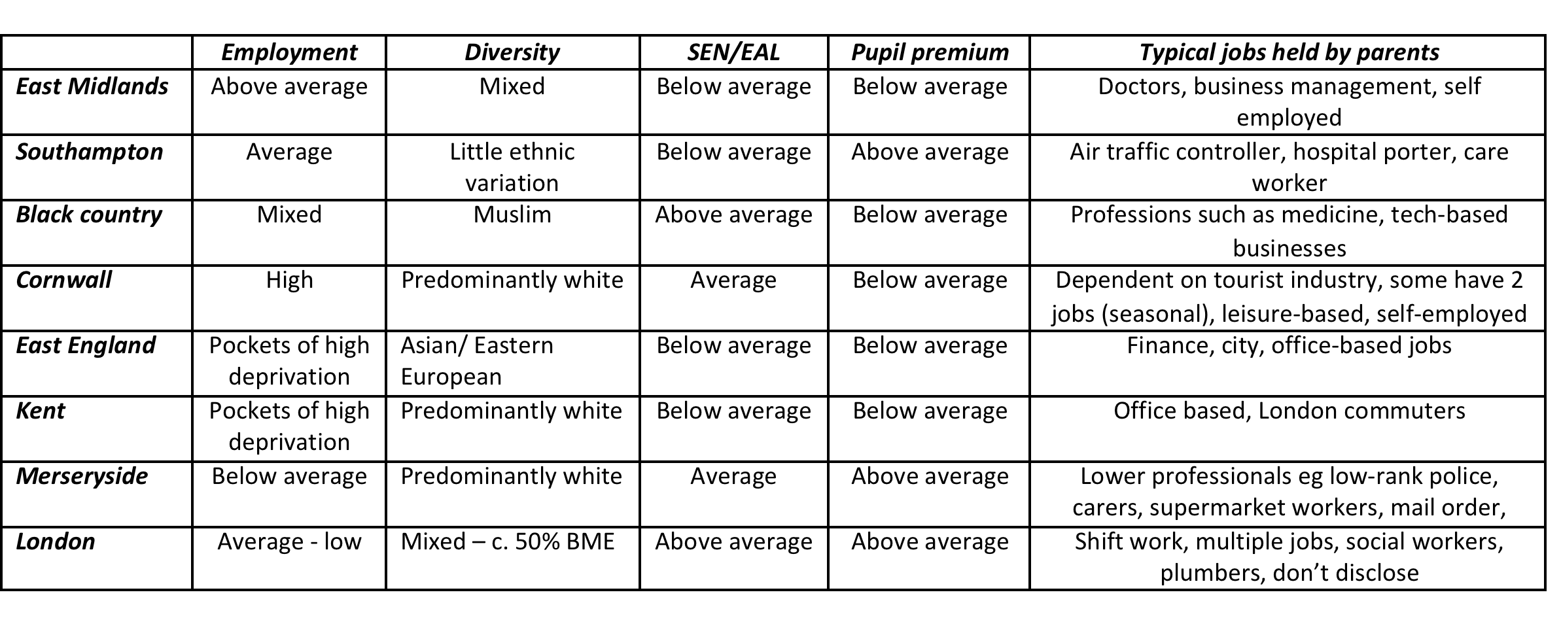
Research design: Tele-depths and parent focus groups
Additional tele-depths with teachers: x 8
2 x parent focus groups
  Tunbridge Wells (B/C1, professionals)
  Aylesbury (Less affluent, community based jobs)

Slide 9
Sample
Total sample = 933 children, 14 parents, 32 teachers

Slide 10
Implementation
Research conducted during October and November 2016

Slide 11
Career aspirations: overview

Slide 12
Which careers appeal?
Incorporated into the various sessions and the survey was the open question: What job would you like to do?
The majority of children had an opinion
  Only 24 skipped this question in the survey (3%)
  Enthusiastic response in other sessions – keen to share and confident of choices
Choices based on:
  What they know (home, school), frame of reference
  What they enjoy (academics, hobbies, interests)
  What they have seen (media: TV and increasingly online)
  What they have experienced (personal encounters, particularly medicine)
  Their environment (particularly evident amongst small, rural community)
  Who they know (family and friends with jobs that interest them)
Many children and parents noted that their/their children’s dreams have changed over the years, reporting what teachers confirmed to be a very traditional flow of choices based on experiences as young people mature.

Slide 13
Aspirations can change according to experience
Teacher
Person
Only job they know
Gymnast
Enjoyment
What I like
Scientist
Success
You Tuber
Subject I’m good at
Aspiration
Influence and self-belief
Example progression of ideas
Primary school

Slide 14
Range of desirable careers
When given free rein, most choices fell within these categories
With few exceptions, health careers were rarely spontaneously mentioned
Careers
Sport / leisure
Music
Animals
TV and internet
Fashion/beauty
Coding and gaming
Art/photography
Forces and police
Drama and dance
Science
Footballer
Vet
Singer
Marine Biologist
Actor
Architect
Chef
Zoo keeper
You Tuber
Astro -Physicist
Dentist

Slide 15
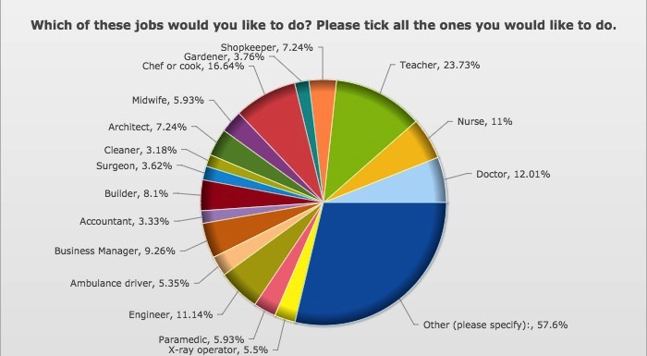
Desirable careers

Slide 16
Aspirations: Differences
Top career choices for girls
Top career choices for boys
Teacher
Chef or cook
Nurse
Doctor
Midwife
Engineer
Chef or cook
Builder
Business manager
Teacher
Top career choices for younger
Top career choices for older
Teacher
Chef or cook
Nurse
Shopkeeper
Doctor/ Builder
Teacher
Chef or cook
Doctor
Engineer
Business Manager/Nurse

Slide 17
The impact of perceptions
Traditionally female roles generated greatest disparity in response
  Girls ten times as likely to want to be a nurse (C. 20% girls vs. 2% boys)
  And over three times more likely to want to be a teacher (Almost two thirds of girls versus 11.5% boys)
  Midwife (Almost unrepresented amongst boys) versus 11% of girls
Similar patterns amongst traditionally male jobs
  Four times as many boys want to be a builder (only 3% of girls)
  Engineer four to five times more likely to be selected by boys – only chosen by 4% of girls
  Business manager has male bias (12% boys versus 7% girls)
  Twice as many boys want to be an architect

Slide 18
The impact of perceptions

Slide 19
A perception that there are more opportunities for boys?
Boys were more likely to select and suggest ‘other’ careers
  62% of boys versus 54% girls
  70% of Year 6 boys versus 48% of younger sample
  Boys repertoire more extensive than girls. Other traditional jobs suggested included
    Pilot Police Soldier Archeologist
    Fireman Vet Inventor Train driver
    Architect Lawyer
  Amongst girls, vet was a popular choice, but only isolated mentions of police, dentist and farmer.
  A notable number of boys’ choices related to science
    Astronaut Microbiologist Marine biologist
    Astrophysicist Paleantologist Scientist
  Comparably, amongst girls, only one mention each for scientist, technician, marine biologist

Slide 20
Any other influencing factors on choices?
Examined differences between responses from different schools and hence different catchments
  Largely reflected cohort, i.e variations in responses reflected bias amongst sample of male or female and/or younger or older respondents
  Other influencing factors:
    Jobs held by parents and/or family members – exposure to careers
      Architect and engineer outperformed in area where parents most likely to hold these positions
    Socio-demographic / affluence
      Cleaner rated above average amongst lower demographic (5% versus 1%)
    Cultural influence
      Doctor and accountant ranked above average amongst children from Asian / Eastern European homes with high aspirations for their children

Slide 21
New careers
Teachers and parents both commented on the speed at which the jobs market is changing and the challenges this presents
  Year 6’s now working on coding and programming in school that those now in Year 9 did not do
  Aware that many jobs their primary aged children will do, do not yet exist.
  Less affluent parents with less senior jobs expect schools to offer advice and guidance, compared to those of a higher socio-demographic who feel more capable of offering guidance or of being connected to someone who could help
Conversely, young people embrace new careers
  internet / computer based, non traditional roles such as you Tuber or game designer included amongst ‘other’ jobs listed in the survey amongst all ages and in all the face-to-face sessions
  Apparent amongst choices of Years 3 and 4 students as well as older

Slide 22
Exploring current awareness among the primary school audience of roles in health

Slide 23
Appeal of health related careers?
  Health careers rarely featured in open discussion around career aspirations
    Most likely to be considered by those whose families worked for NHS
    Or those with particularly strong professional aspirations, for example to be a doctor
Reflected in the survey results
  Beyond doctor and nurse, midwife, X-ray operator and paramedic were only selected by 6% of respondents
  Health related careers not included in the list of ‘other’ jobs that almost 400 young people had detailed

Slide 24
Appeal of careers in health

Slide 25
Appeal of careers in health
Careers in health have greater appeal amongst females and younger respondents
  Bias towards females most apparent for stereotypically female roles
  However, most strikingly, the role of doctor, surgeon and paramedic were selected by a greater proportion of girls
Overall, boys’ choices were more polarised
And boys were more likely to suggest a job not listed
  Apparently still attracted to aspirational rather than realistic roles
  Profile of person who works for NHS suggests characteristics they might consider more female and hence less for them, i.e: kind, caring, helpful, keep trying, hard working

Slide 26
Potential appeal of health careers?
Appeal appears to be directly related to awareness
  Girls instinctively have greater interest and therefore knowledge
  Girls more likely to have pre-considered health careers and identify with the skills and qualities required
However when pupils engaged in depth discussion around the many and various roles in health, two common trends emerged:
  Careers in health emerged as part of wider repertoire of jobs they would like to do or had considered
  Most could readily identify a role that would interest them and cited a wide range of roles (particularly when they realised there were jobs that didn’t involve direct contact with blood or needles!).
Doing a ‘non-medical’ job for NHS appealed as they would be making a difference, they would be helping people if they were working for NHS

Slide 27
Example comparisons from paired depths
What job would you like to do
What job would you do for NHS?
Computer engineer
Footballer
Gymnast
Artist
Work in space industry
Builder
Vet
Rugby player
Paramedic
Author
Inventor
Microbiologist
Surgeon
Ambulance driver
Paramedic
Doctor
Radiographer
Something ‘back stage’
Nurse
Sports physio
Cardiologist
Driving ambulance
Training

Slide 28
Example comparisons from careers sessions
What job would you like to do
What job would you do for NHS?
Gymnast
Video games maker
Engineer
Footballer
You Tuber
Chef
Computer coder
Mechanic
Accountant
Nurse
Police
Make up artist
Actor
Lawyer
Doctor
Mechanic
Paramedic
Security
Blood transferer
Cleaner
Ambulance driver
Dentist
Accountant
Surgeon
Gardener
Chef/cook
Doctor (x 5)
X-ray person
Nurse
Children’s Nurse
Receptionist
999 Call operator (x 8)
Note impact of Step into NHS film

Slide 29
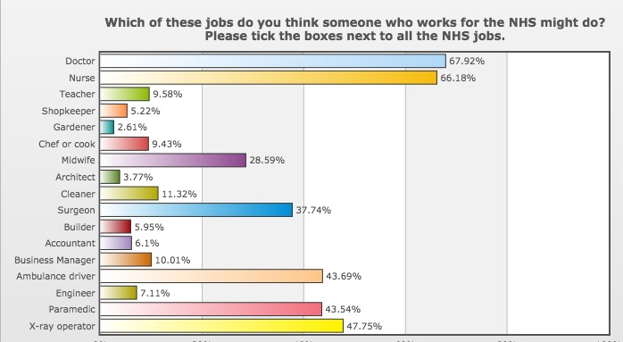
Understanding of roles in NHS

Slide 30
Identifying roles in NHS
The roles most likely to be identified were those classified as medical careers. However;
  A third failed to identify doctor and nurse as working for NHS
    Perhaps attributed to insight that many thought local doctor(GP) did not work for NHS
    And a considerable number have had no contact with medical staff beyond local GP surgery
  Less than half identified Paramedic or X-ray operator
  Little more than a third identified the role of surgeon
  Greatest level of uncertainty over Midwife, selected by just over a quarter of respondents
Response was not affected by age of respondents. However, girls were more likely to identify roles in health, reflecting their greater level of interest / engagement
Unsurprisingly very few identified non-medicine related roles as ‘health careers’

Slide 31
Understanding NHS
Lack of awareness of roles is perhaps related to a broader issue of a lack of understanding what NHS is?
  Confusion over acronym for some: National Health Centre?
  Unable to conceptualise – ‘‘So does everyone at NHS work in one big building?’
  Limited vocabulary for medical roles – ‘the desk lady’
  Spontaneous questions in an attempt to clarify
‘Is our town in the NHS?’
‘Does a dentist work for NHS?
Suggestion that a vet might work for the NHS
And an assumption that people only work for NHS if they work in a hospital

Slide 32
Extent of roles in health
Unsurprisingly they had little concept of the number of careers available
  Most likely to guess between 20 and 40 different roles
  Shocked when the true statistics were revealed
  But very readily comprehended this reality – when they thought about it, it made sense
  Comprehension triggered interest in a very diverse selection of roles and considerably heightened engagement
    I could be a blood transporter
    Do they have mechanics? I’d love to do that.
    What about security?
    I think I’d really like to be an accountant for NHS
    I could do the job (micro biology) I love for NHS – I could do research and make people better

Slide 33
Understanding individual roles
In general, primary pupils do appear to have a basic understanding of some of the other better known careers in health such as surgeon or paramedic, however language is simplified and they rarely describe jobs with correct terms:
  Desk lady rather than receptionist
  Injection person rather than anesthetist
  X-ray person rather than radiographer
  I get confused between a pathologist and a phlebotomist
Those that have had personal experience with hospitals, either through ill health or a relative’s job have a considerably higher command of language and understanding in relation to individual jobs / careers.
Limited understanding directly impacted potential for stereotyping

Slide 34
Understanding individual roles
Doctor and nurse are the two roles most commonly mentioned, however it is wrong to assume that these children might understand these roles
Considerable evidence of confusion, misconception and stereotyping
I thought doctors were all men but then I went to my doctors and I saw a lady with a badge saying Dr
I don’t really understand what a nurse does – is she there to help the doctor?
I thought doctor and nurse was the same job but only women could be nurses and men could be doctors

Slide 35
Gaining a better understanding of stereotypical views among primary school age children and their school teachers

Slide 36
The school environment
Great efforts are made by schools to create an environment free from stereotyping and prejudice and to promote opportunities for all
  Fundamental to the school ethos and values
  Adopted throughout the curriculum
  Teachers select resources that reflect diversity and inclusion
  Care over language when referring to an individual role
  Look for opportunities to promote via whole school initiatives and within taught curriculum
  Identify priority groups to support and promote equal opportunities
  Promote diversity (from representing the make-up of the school, to ensuring pupils are exposed to diversity in a predominantly white British catchment area)

Slide 37
Strategies in the classroom
Careers session
Identifying evidence of stereotyping in resources
Examples of ethic minorities to dispel ‘male, pale and stale’ stereotyping
Female role models in traditionally ‘male’ careers
Challenging pupil thought processes
Gender neutral language
Deliberate choice of stereotypical images to provoke

Slide 38
Teacher views on the roots of stereotyping
Strategies relating to stereotyping vary according to school catchment
Primary school teachers suggest ideas / aspirations come from home
Challenges noted:
  Parent aspirations for children to follow professional careers
  Pressure from the community
  Work ethic amongst differing communities
  Varying perceptions of the value of education
  Influence of a home environment / family structure
  Families from lower economic backgrounds have much lower expectations (noted by teachers who have worked in multiple schools)
Discussions amongst parents did not suggest obvious promotion of stereotyping
  Supportive of aspirations at this stage
  Positively acknowledge broad ranging opportunities available
  Compare with their own much narrower field of reference

Slide 39
Exploring the views of primary school age pupils
What they are taught
Jobs can be done by everyone
What they think/recall
Stereotyping evident
Contradiction evident throughout all tranches of research and in their individual career choices
Opinions are deep rooted and formed almost subliminally - suggests a need for early and repeated messaging
The pupil focus groups presented an opportunity to explore reasons behind responses to the survey

Slide 40
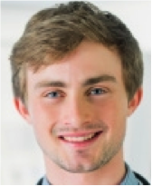
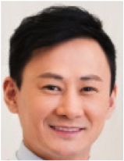
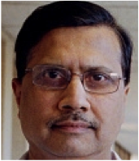
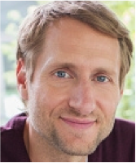
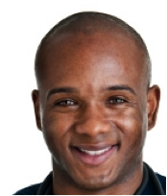
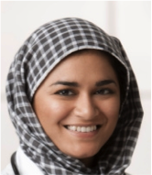
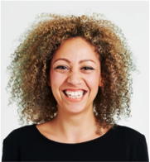

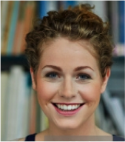
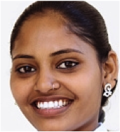
Exploring stereotypical views amongst young people
A B C D E
F G H I J

Slide 41
Doctor
72% chose a male
Options A, B and C received 2/3 of votes
Girls marginally more likely to choose a female
Only 25% of boys chose a female
Asian female most frequently selected (13%), particularly amongst younger (almost 20%)
Remaining females achieved only 15% of votes collectively
Least affluent were least likely to choose a female
Evident that NHS is considered to have a diverse workforce
Stereotyping applied predominantly to gender and age
I imagine a woman being a vet not a doctor
A doctor has to be really clever, not old but not very young either
Men are normally like doctors and nurses are normally ladies
He looks like my brother’s doctor
I think of doctors as foreign, many of the doctors on TV are

Slide 42
Children’s nurse
71% chose a female
Options H, I and J received 55% of votes
Top 4 choices were all women
Girls marginally more likely to choose a female
Only 25% of boys chose a female
Young white male most likely to be selected from men presented
Opinion evenly divided between remaining male candidates
Three—quarters of least affluent chose a female versus 63% amongst highest demographic
You’d associate children with women – children feel more comfortable with a lady
A nurse helps to make the beds
A nurse can be young or very old
She’d be happy so if you were scared she’d calm you down
Nurses are there to help the doctor
Is it the same job? And you call women nurses and men doctors?
She would need to be kind

Slide 43
Paramedic
80% chose a male
Top 5 places were men
Young Asian woman received most votes amongst the female options (8% overall) and was most likely to be selected by pupils from the most diverse catchment areas (14% of London borders pupils)
Boys and older pupils were slightly less likely to choose a male (reflected in response from schools with female bias)
Amongst most ethnically diverse black male selected (marginally) as first choice versus last of 5 male choices amongst least diverse
They’d have to be good at driving fast and not get travel sick
Girls might get more upset
He needs to be strong and muscled
Men are better at dealing with blood and guts
That’s the Paramedic from Casualty

Slide 44
Surgeon
72.5% chose a man
80% of girls chose a man
Top 5 places were men
Age of respondents didn’t impact this pattern
Young Asian woman, closely followed by older white woman received most votes amongst the female options (8% and 7%)
Amongst most ethnically diverse, Muslim female selected (marginally) as first choice amongst female options and black male received almost as many votes as their first choice.
Men have more experience of building things and have steadier hands
Men are more focused, girls are all over the place, might get distracted
You’d be quite old as you have to do lots of training
You couldn’t be too old as your hands might get all shaky
They’re really clever – more clever than a doctor or nurse
You can’t be faint-hearted

Slide 45
Answers 999 Calls
Far less gender distinction – 57:43 male/female selection overall
Most even split of votes amongst choices
No obvious influence on pattern of responses pattern in responses
It doesn’t matter if it’s a man or woman who answers the phone
I forgot, I had a man and a woman choice
It doesn’t matter who passes the call on to get the message over
Women have a lighter voice – you’d feel more confident as men sound angry
Men would be more serious, women would be more friendly
Men have more memory, don’t get distracted
But it matters if you’re the ambulance driver – men are faster drivers

Slide 46
Exploring stereotypical views amongst young people
NHS employee
Top 3 rank for all but nurse
Surgeon or doctor
Doctor or surgeon, familiar
Chosen less than other males
Teacher?
Friendly, most likely 999 or paramedic.
Casualty effect?
Rarely chose, she looks nice, maybe on reception
Least likely to be NHS employee. Too
messy
999 operator or children’s nurse
Perhaps too old to be doctor?
Children’s nurse
Young, friendly
Looks like a nurse or doctor
Brown hair, tied back

Slide 47
Exploring stereotypical views amongst young people
Doctor, or an office job
Dentist
Doctor (retired, very old)
Dad, works from home
Lawyer or lorry driver
Shop keeper, market seller
Yoga teacher
Teacher/ headmistress
Librarian
Dentist or hairdresser

Slide 48

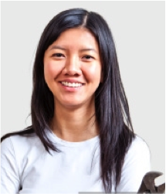



Which role?
Over 50% chose nurse
One quarter thought she answered 999 calls
Just over a fifth selected doctor
Very few votes for plumber or engineer
Girls more likely to choose doctor (24% versus 19%)
Most notable difference amongst more affluent – over a third chose doctor (female bias)
Younger more likely to choose nurse
That’s what nurses look like
She doesn’t look as though she’d like to get dirty
The plumbers that come to our house are all men
Engineer doesn’t suit her, that’s a man – someone serious and bald
Plumbers are men – that’s a man’s job

Slide 49

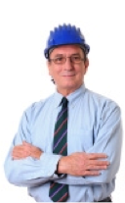

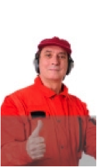
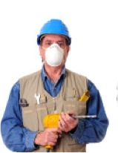
Which role?
Almost two-thirds chose surgeon
Manager selected by c. 20%
Builder was chosen by 8% of children
Girls were marginally more likely to select surgeon, whilst boys were more likely to select manager
Older children more significantly likely to select surgeon (71% versus 51% of younger
Greatest correlation in response was between areas of higher and lower socio-demographics
More likely to select manager over surgeon compared to whole sample
Highest rating for builder where manual jobs predominate
Engineers fix engines and he’s not wearing overalls
He looks experienced enough to be a surgeon
He looks old enough to be a manager and that’s a serious job too
Not a builder – that would be a man but someone younger, stronger
A surgeon is a serious job, he suits being serious

Slide 50
A general misconception: Gender
Some jobs men do and others ladies do
Mostly children spend more time with their mum – the man does the more manly job
Teachers are more female
Baker sounds like a lady, chef like a man
The dentist is a man and women are helpers
A paramedic is more of a man thing
A doctor is a more realistic job for boys
Engineers are men like plumbers and builders
Doctor sounds more manly - I always thought a nurse had to be a girl and a doctor had to be a man
Pilots are more male than female
When you go to a chemist there are lots of ladies serving you but the person at the back making the medicine is a man – the boss?

Slide 51
A general misconception: Age
Age matters
When you get older your hands could be really shaky
You may not be able to hear as well so you couldn’t answer the phones
You couldn’t be a surgeon or do stitches
At 67 you couldn’t be a doctor. It’s an important job and you might get ill
If you were taking calls you might say the wrong stuff and might forget
You can still be a nurse when you are older
You could be slow picking up the phone
I would expect the desk lady to be old

Slide 52
Identify potential influences on stereotypical views among primary school children

Slide 53
Seeking potential influences
It seems schools can be discounted as a source of stereotypical viewpoints
Equally, parents from all backgrounds reiterate the values delivered through schools
  Support to help children achieve what they want to be
  Do something you love
  High aspirations even amongst lower demographics
Whatever their aspirations, parents balance support and enthusiasm with guidance, although approaches may differ
  Support for the dream v. support for an alternative in case the dream does not materialise
Parents and teachers agree children should be open to and exposed to many opportunities at this stage in life
  Very evident that parents are embracing the breadth of opportunity their children have available to them (in contrast to their own choices) and want them to embrace this

Slide 54
So what are the greatest influences?
Demo-graphics
Neighbour-hood
Personal experience
Media / role models
Home/family
School

Slide 55
Potential influences
Demo-graphics
Neighbour-hood
Personal experience
Media / role models
Home/family
School
Age of child
  Move away from traditional job aspirations
  Young are more likely to be attracted to new seemingly exciting careers
Gender of child
  Girls appear to be more stereotypical in views about careers
  Smaller repertoire than boys and seemingly happier to consider more traditional roles
  Perhaps don’t believe they have as many opportunities
  Health careers appear to be more attractive to girls

Slide 56
Potential influences
Demo-graphics
Personal experience
Media / role models
Home/family
School
Neighbour-hood
Diversity
  Diversity of neighbourhood directly impacts likelihood to see and accept diversity represented in local workforce
  Knock-on impact of perceptions: ‘It’s usually foreigners that do that job’
Socio-demographics
  Impacts exposure to range of careers
  Patterns of work amongst family members may impact on perceptions of achievable careers
Landscape
  For rural community relying on tourism, community shapes what they want to be
Culture
  Expectation to follow professional career paths, though changing with time
  High ambitions of parents who want things to be better for their children

Slide 57
Potential influences
Demo-graphics
Neighbour-hood
Media / role models
Home/family
School
Personal experience
What they have seen
  Experiences relating to health
  Gender, age and appearance of doctor, nurse, dentist, radiographer, surgeon etc. forms their perceptions
Who they know
  Extent of knowledge and language directly related to personal experience and also to whether a member of the family works for NHS
  Natural assumption that other members of NHS staff doing the same job as family member or friend will be similar

Slide 58
Potential influences
Positive role models in soap operas / hospital dramas were noted by children, teachers and parents
However this influence does not appear to be impacting as effectively as might be expected
  High popularity of shows
  High levels of recall of characters
  Engagement on emotional level (OBEM)
  Need to dispel myth of association with blood etc.
In comparison Chef / Cooking career is equally appealing to both genders, largely attributed to positive role models and exposure on TV
Social media introduced them to aspirations to be You Tuber or gamer
Social media most influential for children whose parents are less engaged
Demo-graphics
Neighbour-hood
Personal experience
Home/family
School
Media / role models

Slide 59
Potential influences
Demo-graphics
Neighbour-hood
Personal experience
Media/role models
School
Home/family
Some evidence of children wanting to follow career of parent or family member (not peers)
Parents supportive – may promote importance of higher level education rather than specific careers
Most engaged parents are most influential – give children experiences to help shape aspirations
However, family structure appears to influence perceptions, in particular of female roles, e.g
  Father with full-time profession and mother working part-time around children
  Lower income households requiring second salary - shift-work avoids need for childcare
  Single mums require flexible work as primary carer
Children perceive females to be the ones to work in caring professions, linked to children

Slide 60
Potential influences
Demo-graphics
Neighbour-hood
Personal experience
Media / role models
Home/family
School
Inadvertently the profile of primary teachers (predominantly female) may add to children’s perceptions that women do jobs related to caring and helping

Slide 61
Explore opportunities in the KS2 curriculum for Health Careers to engage with primary schools

Slide 62
‘Every state funded school must offer a curriculum which is balanced and broadly based and which … prepares pupils at the school for the opportunities, responsibilities and experiences later in life’
The National Curriculum in England: Key Stae 1 and 2 framework document

Slide 63
Interpretation by primary schools
Opportunity for careers teaching
Deliver a broad and balanced curriculum
Develop the whole child, a better person
School values and ethics based to dispel stereotypes and misconceptions
Develop aspirations and shape for the future
Open minds and inspire, develop thoughts, ‘pupil voice’
Don’t shut doors – Introduce role of ‘Innovation’

Slide 64
The opportunity for careers teaching
Taught curriculum
PSHEE themes such as Health, our body, caring / people who care for us, equality, stereotyping and even directly addressing careers as a topic relating to finance and education pathways
Non statutory but all schools must make provision for programme of study in personal, social, health and economic education
Links through other subjects such as science but opportunity limited

Slide 65
The opportunity for careers teaching
Visitors / speakers to support topics
Examples include astro scientist to talk about space, women in science, people in local community, tradespeople on site
Whole school initiatives
Dress up as want you want to be
Real people, positive role models to dismiss pre-conceptions
Limited approaches, schools must proactively seek out
Themed assemblies (one off or wider series on careers)
Collapsed curriculum careers day with speakers (parents, community) – children want to know how they got the job as well as what they do
Careers day to support theme such as caring
School nurse presents an opportunity
Open to ideas beyond those recognised at home

Slide 66
Teachers understand the benefits of careers teaching
Pupils have no idea of the opportunities available to them
Some of them seem too young to know what they want to do but counteracting stereotyping can benefit them immediately
Planting seeds can open up further discussions
Pupils don’t see that they are building up their skills throughout their school years in order to go out to work ‘life skills’
Girls do become more realistic about careers before boys
It’s never too early to introduce receptive language

Slide 67
Resources to aid delivery
The extent to which schools currently deliver careers varies hugely
Estimated time = up to 10 hours filtered through
What is apparent is that they don’t have many resources available to them
Many jobs today outside the concept of what teachers feel comfortable with – things have changed…
Videos are definitely better than listening to a teacher
A wide ranging resource introducing lots of careers and explaining the role
… If there was material available on careers I would definitely use it

Slide 68
Magic wand
Best careers tool
Primary work experience
Work shops
Posters of typical days / events
Brilliant club for all
Advice on running careers day
Health speakers (any role)
Broad based resource
The extent of suggestions reflected the value attributed to careers teaching

Slide 69
Explore response among primary children and teachers to Step into the NHS website and materials

Slide 70
Resources tested
Step into NHS competition video
Career mapper and careers A-Z
Step into NHS Videos
Step into NHS website
Patient Journeys: Danny
Real life, your life?
Meet.. Videos

Slide 71
Universal appeal of Step into NHS
‘I really like that – it makes you think about real life stuff. So rather than say to your child that entails a lot of work, this makes them think about it by writing a job description’ (Parent)
‘That’s excellent. I like that… it’s better than careers advice because they’re researching it themselves’ (Teacher)
‘I really like it because it’s not just telling you this is a job and blah blah’
‘It makes you feel really excited and gets your attention.’ (Pupils)

Slide 72
Response from teachers
Teachers universally liked the flexibility and inclusive nature
Even the school with very limited opportunity for careers teaching identified an opportunity to deliver through a series of career themed assemblies before launching the competition
Step into the NHS comprises some really beneficial student tools that would help to bring a real life feel to things they currently teach theoretically
With only minor alterations Step into the NHS would be accessible for upper Key Stage 2 students
  Provide real examples of job descriptions for real jobs
  Career mapper is really fun but it should identify jobs they might like to research. Avoid inferring career recommendations as this may have the opposite effect of narrowing their thoughts

Slide 73

Response from teachers
The most helpful resources are those seen through the eyes of children
  Appeal of ‘Ramp’ video versus ‘Meet’ videos which are deemed too dry and language inaccessible
  Simplified version of Danny’s journey (as poster or stepped PowerPoint) versus other patient journeys which are deemed far too complex
  Simple version of Real life, Your life PPt that gets them thinking about their skills and strengths to broaden thinking
And those that are time saving
  List of careers to research easy to access from one place
  Short summary of key points for each to introduce a wide range of careers
  Won’t extend into what it’s like to work for NHS or career paths – this will be treated as an introduction to careers only

Slide 74
Reaching teachers
Write to schools. Mail more impact than emails
  Stays in staffroom
  Tangible reminder
Email once established communication, recognise sender
Catch their eye, be bright and colourful and immediately capture their imagination
FAO PSHE Coordinator but with a strong message on the outside of the envelope
  Open it knowing that it can help them
  The word free is important

Slide 75

Response from pupils
Genuine enthusiasm – even disappointment when they learnt it wasn’t for them.
Understood mechanics and felt capable (Y5/6) of taking part
Prefer to enter in pairs / groups
Then confident to take on both parts – job description and advert
Favourite support tools:
  Career mapper – accessible for Year 6 though maybe too many questions
  Ramp video – relevant, seen through their eyes
  Careers A-Z: research tools require bitesize, colourful information to deliver core facts
  Poster of Danny’s story (simplified)
  Video diaries but must be more dynamic
Really engaged with plenary task to choose a career

Slide 76
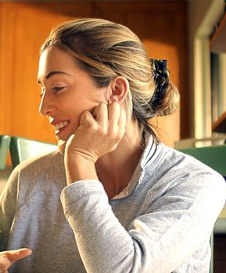
Response from parents
Immediate recognition of the benefits of Step into the NHS
  Makes them think about real life
  Shows them so many different opportunities
  Links school to world of work
  Helps them to build a picture
They could support their child in a non-academic project like this and it provides an opportunity to talk to their child
Position as a broad introduction to careers – make sure the opportunity is there to research the widest possible selection
Tools that feature careers over NHS preferred
  Competition video
  Career mapper
  Careers A-Z
  Ramp video seen from kids eyes

Slide 77
Conclusions

Slide 78
Conclusions
Stereotyping is evident amongst primary school pupils – limited frame of reference
Equally evident was the firm decisions of some children as to which career they wish to pursue – not many are considering careers in health
Opinions are deep rooted and formed almost subliminally - suggests a need for early and repeated messaging
NHS can surprise and inform about careers
Step into the NHS is a suitable vehicle to help primary schools deliver careers
  Deliver teacher need for resources, linked to real life
  Engage pupils (evidenced in their response having seen the video)
  Encourage support from parents

Slide 79
Conclusions
Engaging in careers through this type of project can really change perceptions
  Not only to reinforce the views of those that have always considered a career in health
    ‘I want to be a doctor because I want to make people better and see happiness in their eyes’
  But also to impact on those that had never previously considered this or realised the extent of opportunity
  ‘ I could do my job, the one I want to do – but this way I would be really helping people’

Slide 80
THANK YOU

